Slide 1


Slide 2
Design, seepage analysis and controls of waste dumps

Slide 3
Introduction
In recent years, there are numbers of landslide occur everywhere. Most of the landslide happens on the cut slopes or embankment along roads, highway and sometimes within the vicinity of highly populated residential area especially those in the highly terrain. Thus, a proper understanding, monitoring and management of slope stability are essentially important to minimize the severity or casualty in any landslide.

Slide 4
Factors affecting dump stability
1) Hydrogeological and rain water condition in the dumping area. 2) Load bearing capacity where dump is to be laid. 3) Geometry and strength of the dump material. 4) Methods of dumping. 5) Dynamic loading and Ground movement.

Slide 5
Types of slopes
1. Natural slopes
2. Man-made slopes
The natural slopes are those that exist in nature and are formed by natural causes. Such slopes exist in hilly areas. The sides of cuttings, the slopes of embankments constructed for taking roads, railway canals etc. and the slopes of the earth dams are examples of finite slopes.

Slide 6
Causes of slope failure
1. Gravitational Force
2. Force Due To Seepage of Water
3. Erosion of the Surface of the Slopes Due
To Flowing Water
4. The Sudden Lowering Of Water Due To
a Slope
5. Forces Due To Earthquakes

Slide 7
Objective
The slope stability analysis is important owing to the influence of slope angle upon the design and economics of opencast mining operation i.e.,
1) Steep enough to be economically acceptable.
2) Flat enough to be safe.

Slide 8
Specific objectives
1) Collection of the samples from the field.
2) The analysis of these samples to find out parametric variations affecting the slope stability as the cohesion, angle of friction, density and other parameters.
3) Utilisation of the results of sample collected to predict the stability in terms of safety factor
4) Determination of the factor of safety of the various slopes using the mine plans and sections
5) Valuation of the safety factors and suggest corrective measures.

Slide 9







Methodology

Slide 10
Limiting equilibirium approach
The stability of refuse embankments is usually solved by limit equilibrium methods of analysis. These analyses are conducted by calculating the minimum factor of safety (FS) for a slide surface through the slope as follows:
FOS = Available shear strength÷ Equilibrium shear stress
If FOS = 1, a slope is in a state of “just-stable” limit equilibrium

Slide 11
A factor of safety is defined as that factor by which the shear strength of the soil must be reduced in order to bring the mass of soil into a state of limiting equilibrium along a selected slip surface.
For an effective stress analysis, the shear strength is defined as:
S=c’+(σn-u)tan Ф’
Where:
S=shear strength,
c’=effective cohesion,
Ф’=effective angle of internal friction,
σn=total normal stress,
u=pore water pressure

Slide 12
Method of slices
Where the slip surface under the study for a slope passes through soil materials whose shear strength is based upon internal friction and effective stress, the method of slices is recognized as a practical means to account for the expected variation in shearing resistance that develops along the different portions of the assumed slippage arc. The procedure is applicable to slopes in isotropic soils, layered soils and non-isotropic soils. . The procedure involves dividing a mass assumed to be involved in a slope slide into vertical slices.

Slide 13
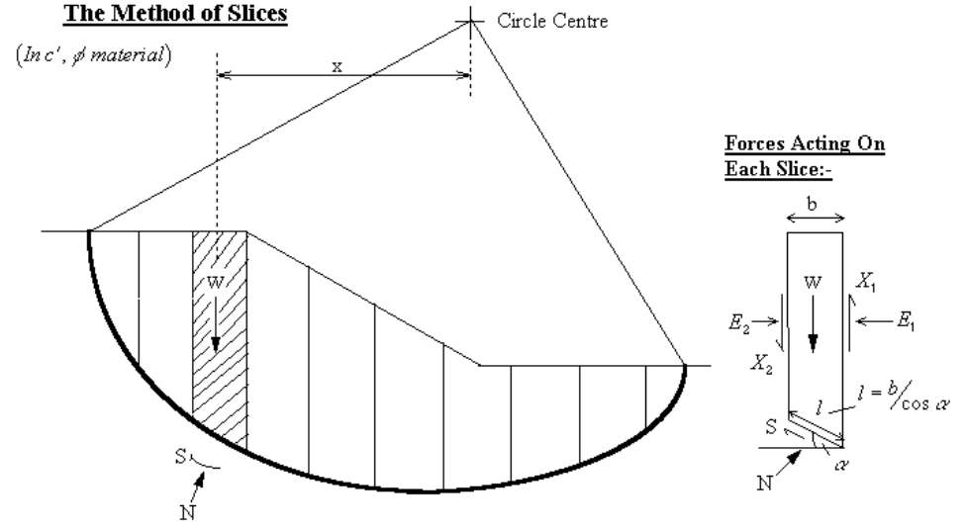

Slide 14
Bishop’s method
A method presented by Bishop utilises method of slices and considers forces to be acting on each slices. The requirements of equilibrium are applied to the slices comprising the slope with the factor of safety against a slope failure then being defined as the ratio of the maximum shear strength possessed by the soil on the trial slippage plane (τ available) to that shearing resistance necessary for equilibrium (τ mobilised) ,
FS= τ available/ τ mobilised

Slide 15
Shear strength of the soil is given by
T available = c’+ (σ – μ) tan Φ = c’ + σ’ tan Φ
Shearing resistance mobilized is given by
T mobilised= [1/ (FS)] [c’+ (σ – μ) tan Φ]

Slide 16
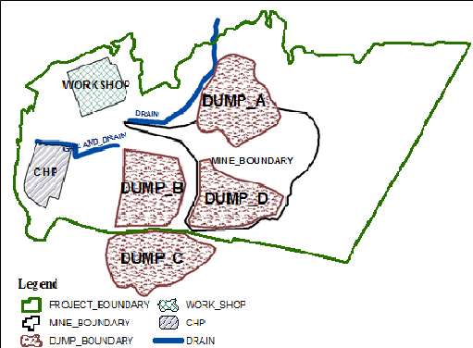
Study area (Sonepur-Bazari OCP)

Slide 17
Design parameters for external dumps
Geo-technical parameters of external dump material.
Geo-technical parameters of foundation strata below external dump.
Hydrostatic force of water flowing through the foundation of dump mass.
Depth of soft soil strata below external dump.
Seismic effect on the dump mass.

Slide 18
Data for external dump
Strength parameters | Dump material | Foundation material
Cohesion(kN/m²) | 125 | 65
Angle of internal friction(°) | 16.5 | 14
Bulk density(kN/m³) | 19.8 | 23.7

Slide 19
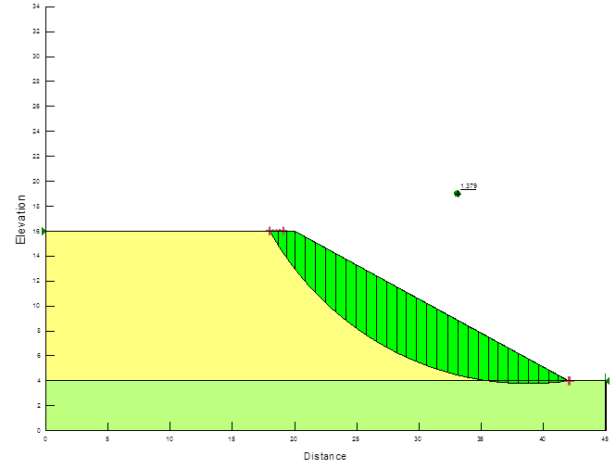
Models for external dumps
For dump height=60m

Slide 20
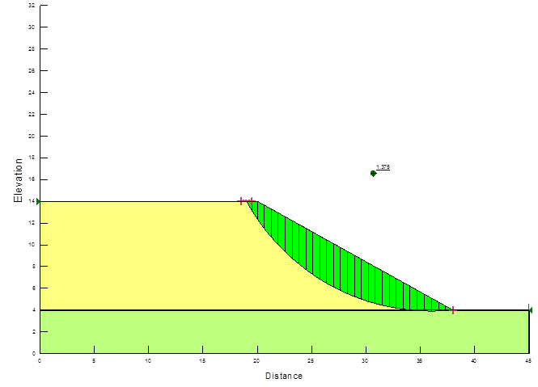
For dump height=50m

Slide 21
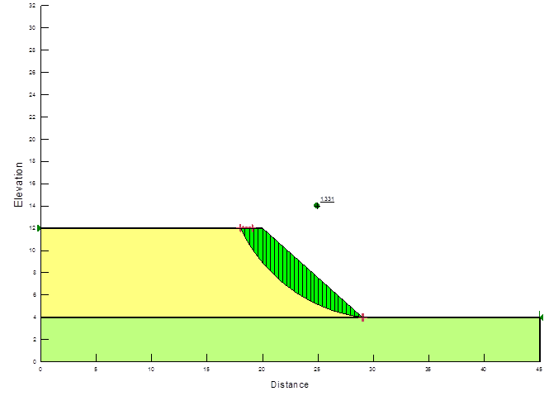
For dump height=40m

Slide 22
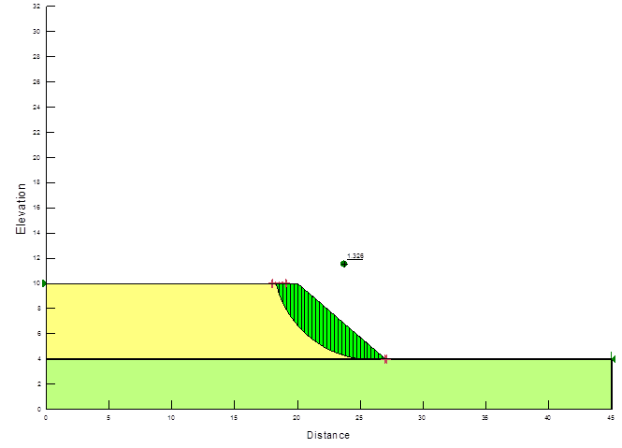
For dump height=30m

Slide 23
Analysis for external dump
Height of dump | Slope angle | Ordinary | Bishop | Janbu | M. price
60m | 26° | 1.311 | 1.384 | 1.289 | 1.379
50m | 29° | 1.297 | 1.38 | 1.281 | 1.375
40m | 36° | 1.293 | 1.336 | 1.28 | 1.331
30m | 40° | 1.275 | 1.33 | 1.261 | 1.326

Slide 24
Design parameters for internal dump
1 Geo-technical parameters of internal dump
2 Geo-technical parameters of interface material.
3Hydrostatic pressure i.e. upward thrust of water exerted on the dump by water table within dump mass.
4 Seepage force of water flowing through the dump mass.
5 Seismic effect on dump mass.

Slide 25
Data for internal dump
Strength parameters | Dump material | Foundation material
Cohesion(kN/m²) | 110 | 55
Angle of internal friction(°) | 17 | 19
Bulk density(kN/m³) | 19.3 | 20.8

Slide 26
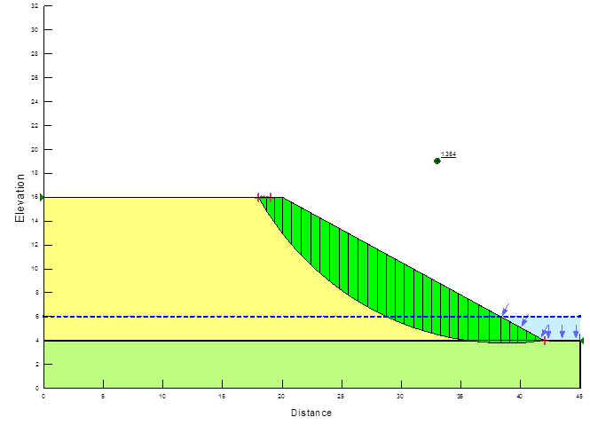
Models for internal dump
For dump height=60m

Slide 27
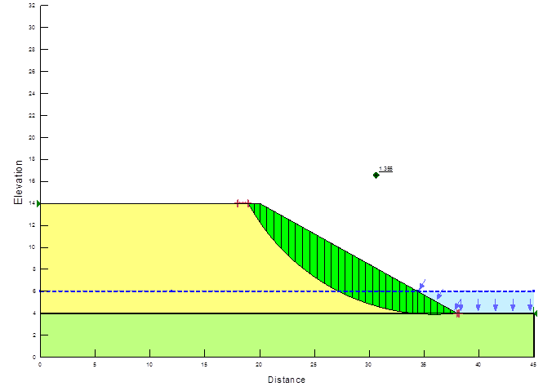
For dump height=50m

Slide 28
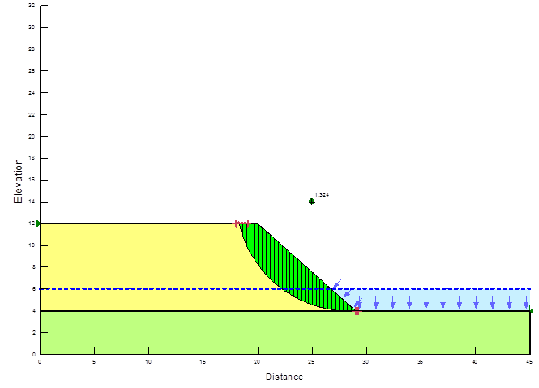
For dump height=40m

Slide 29
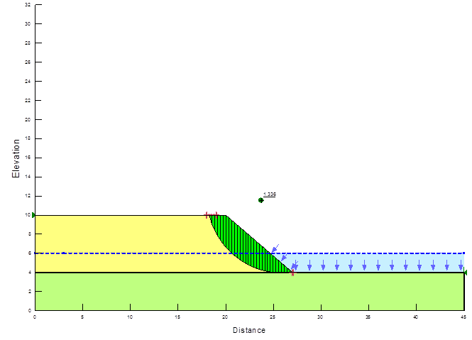
For dump height=30m

Slide 30
Analysis for internal dump
Height of dump | Slope angle | Ordinary | Bishop | Janbu | M. price
60m | 25° | 1.287 | 1.359 | 1.268 | 1.354
50m | 27° | 1.275 | 1.359 | 1.262 | 1.355
40m | 35° | 1.253 | 1.33 | 1.242 | 1.324
30m | 38° | 1.276 | 1.339 | 1.266 | 1.336

Slide 31
Conclusion (for external dumps)
1) The height of the external dump is varying between 30 to 60m which is considered in the stability analysis.
2) The slope angles for external dump is varying between 40 to 26.
3) As per hydro-geological study of the mine, the foundation of the external dump is submerged with ground table. Hence the foundation of the external dump is considered to be in submerged condition for stability analysis.
4) The maximum depth of the soil strata is 20m. Hence the external dump may experience base failure through the 20m thick soil strata leading to floor having near toe of the external dump.

Slide 32
Conclusion (for internal dump)
1) The height of the internal dump varies from 30 to 60m for stability analysis.
2) The slope angles for internal dump is varying between 38 to 25.
3) A seismic force equivalent to horizontal load 0.04*dead load of dump mass is considered here for stability calculation as the mine is situated in zone-3 of seismic zone map of India.

Slide 33
Future scope of work
The stable slopes are essential for safety of men and machine. Also vast amount of land and money can be saved by optimizing slope geometry. It is, therefore, technical and economic necessity that the efficient slope geometry be achieved by optimizing the slope of the dumps.

Slide 34
Slope/w software
Slope/W is the leading software product that used for computing the factor of safety of earth and rock slopes. With Slope/W, engineer can analyze both simple and complex problems for a variety of slope surface shape, pore-water pressure conditions, soil properties, analysis methods and loading conditions. Besides that, by using limit equilibrium, Slope/W can model heterogeneous soil types, complex stratigraphic and slip surface geometry, and variable pore-water pressure condition using a large selection of soil models.

Slide 35
References
Bishop, A.W. (1955) "The Use of the Slip Circle in the Stability Analysis of Slopes," Geotechnique, Great Britain, Vol. 5, No. 1, Mar., pp. 7-17.
Bishop, A.W. and Morgenstern, Norbert (1960) "Stability Coefficients for Earth Slopes," Geotechnique, Vol. 10, No. 4, December, pp. 129-150.
Casagrande, A. (1960) "An Unsolved Problem of Embankment Stability on Soft Ground," Proceedings, First Pan-American Conf. on Soil Mech. and Found. Engrg., Vol. 2, pp. 721-746.
Cousins, Brian F., "Stability Charts for Simple Earth Slopes," Journal of the Geotechnical Engineering Division, ASCE, Vol. 104, No. GT2, Feb., 1978, pp. 267-279.
Crawford, C.B. and Eden,W.J. (1967) "Stability of Natural Slopes in Sensitive Clay," Journal of the Soil Mechanics and Foundations Division, ASCE, Vol. 93, No. SM4, July, pp. 419-436.
Hoek, E. and J. W. Bray, Rock Slope Engineering, Third Edition, The Institution of Mining and Metallurgy, London, 1981.

Slide 36
Thank you

